Slide 1
Crime in Denver
Christopher McCabe
December 2,2015

Slide 2
Background
Why is this of interest?
News Story
Unmarked police car
Interesting to look at crime in and around Denver
What will I find?

Slide 3
EDA
Tables
Tried to see where the breakdowns are per district and per type of crime and date
Type of crime: Traffic-accident and then traffic accident hit and run
District 3 had most incidents
Date: A few up there but 4/20/2012 at 9:59….had a bunch
Conclusions from tables
I decided to focus more on “real” crime and less on traffic violations
Violent: Aggravated-assault

Slide 4
EDA cont.
Graphs
Basic histograms
Scatterplots
Time plots: Crime happened when you would expect, at night
Graph: GIS
To find where districts were (since I was unsure)
This lead into Hierarchal Clustering

Slide 5
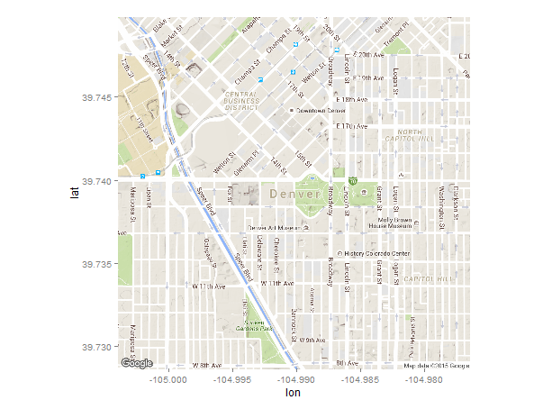
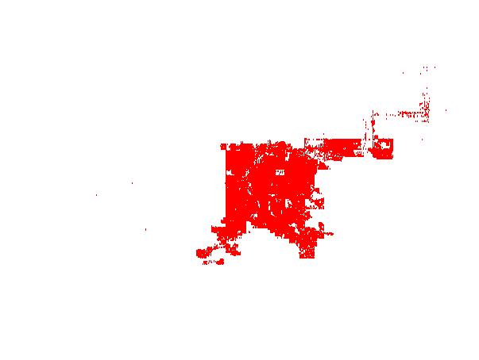
Graphs
GGMAP
Plotting Points

Slide 6
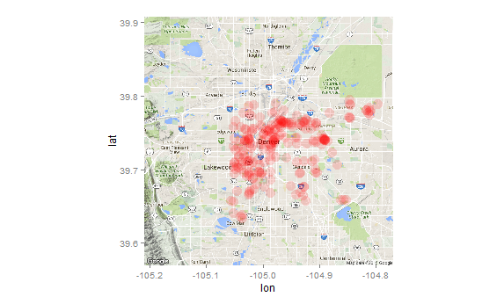
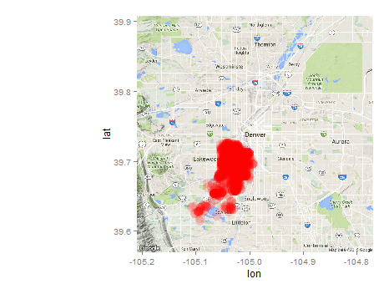
Maps cont.
Murders
My District: All Crime

Slide 7
Type of Modeling Techniques
Clustering
Logistic: My district
Hierarchical Clustering
Used Geo Coordinates
Packages: Geosphere and fossil
df <- earth.dist(datafinal) # distance matrix
hcf <- hclust(df) # hierarchical clustering
plot(hcf) suggests 4 clusters
clustf <- cutree(hcf,k=4)
clustf
Not great
yes = glm(IS_CRIME~ OFFENSE_CATEGORY_ID + REPORTED_DATE + OFFENSE_CATEGORY_ID, data=train_data, family=binomial(link='logit'))

Slide 8
Challenges
Null
Decided to omit most: Relied on Longitude and Latitude, not necessary to try and predict those
Map Making
Really fun, but also challenging and can take some time to run
Deciding what to look at/predict
Clustering
Tree
Logistic

Slide 9
Conclusion
My area is not as bad as I thought
But also not Mayberry
Predicting crime is starting to become a big deal, but this could have some backlash

